Slide 1

Control of a Rolling Balancing System
Timothy Dunn

Slide 2
The Project
Motivation
Modelling and Simulation
Control and State Estimation

Slide 3
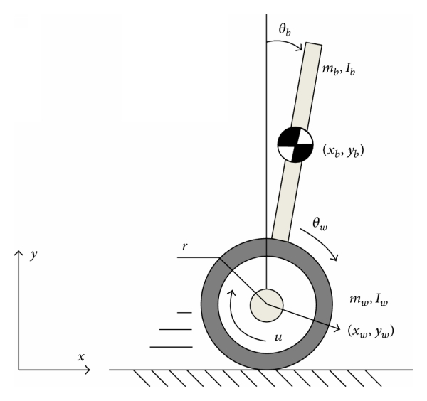
Under-Actuated Systems
https://www.hindawi.com/journals/mpe/2014/284216/fig1/

Slide 4
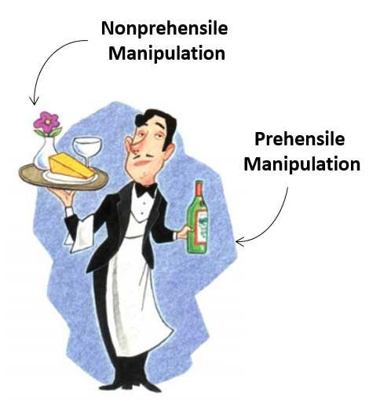
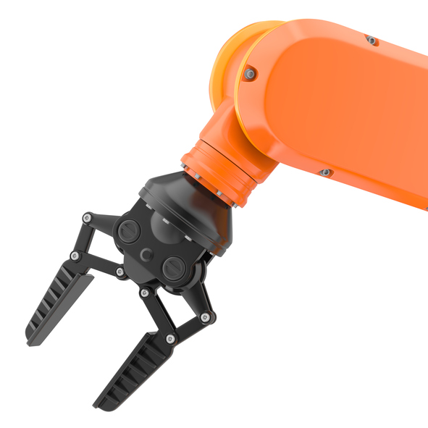
Prehensile Manipulation
https://www.researchgate.net/publication/310751102_Robot_Control_for_Nonprehensile_Dynamic_Manipulation_Tasks
https://www.robotics.org/blog-article.cfm/The-Emergence-of-Smart-Collaborative-Robot-Grippers/107

Slide 5
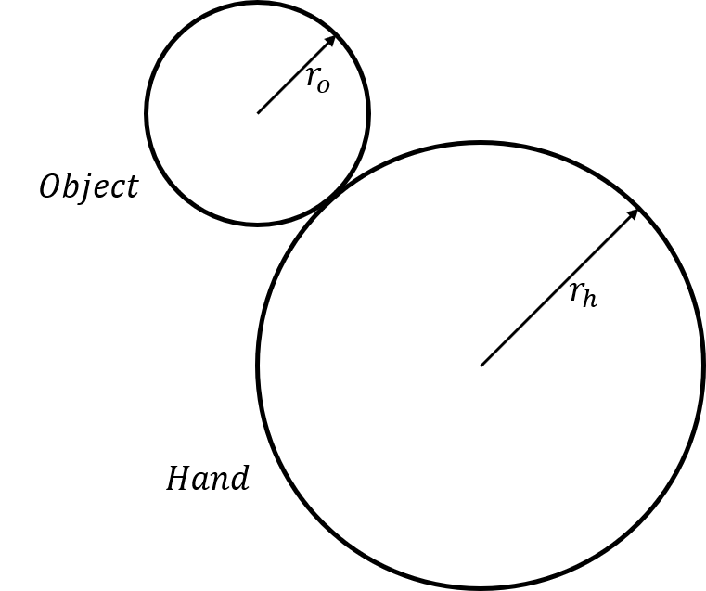
The Disk-on-Disk System

Slide 6
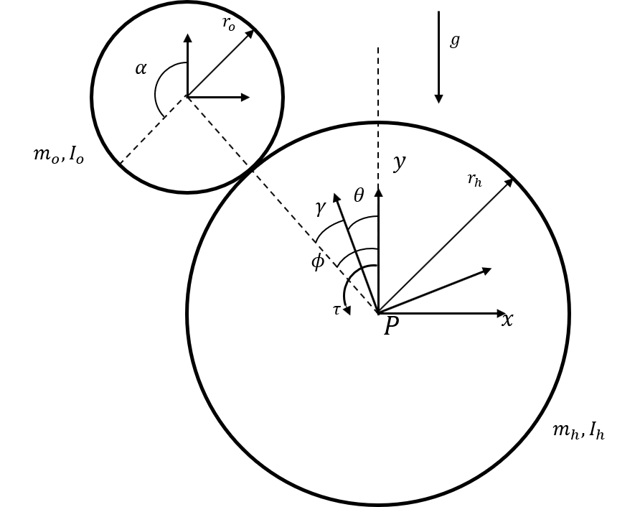
Modelling

Slide 7
Assumptions
Torque transfer between the actuator and the hand is not subject to any dissipation effects.
The object and hand interact without slipping.
The hand and object are always in contact.
The system is always operating near the upright balancing point.

Slide 8
Verification

Slide 9
Control
Linear-Quadratic Regulator
Setpoint tracking with reference-feedforward

Slide 10
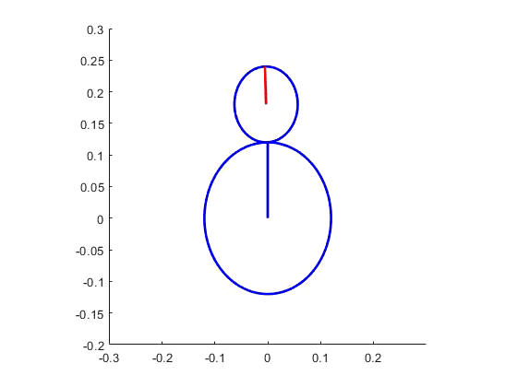
Control

Slide 11
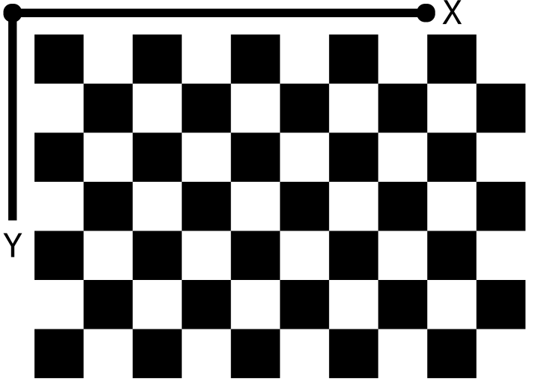
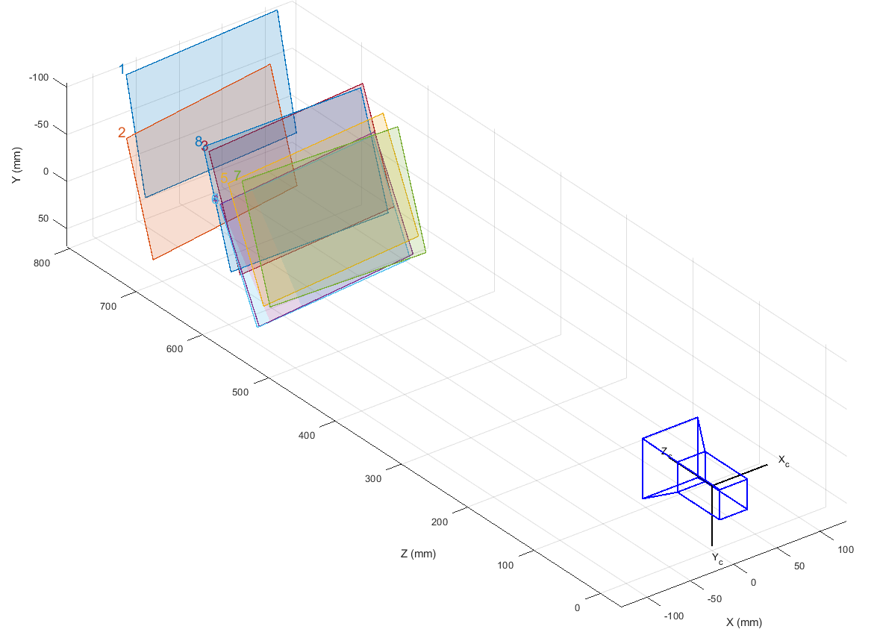
Camera Calibration

Slide 12
Image Distortion
Distorted Image
Undistorted Image

Slide 13
Reprojection Errors

Slide 14
Saturation Thresholding
Hue, Saturation and Value (HSV) Representation
Binary Representation

Slide 15
Blob Detection

Slide 16
Experiment Apparatus Construction
Currently underway – stay tuned

Slide 17
Questions?

Slide 18
Control

